Slide 1
Multivariate Regression
Dr Michael Marshall

Slide 2
Content
Bivariate regression – what is it, why do we use it, how does it work
Bivariate regression – worked example and interpretation
Multivariate regression – purpose, worked example, interpretation
Interactions
Assumptions of regression
Transformations

Slide 3
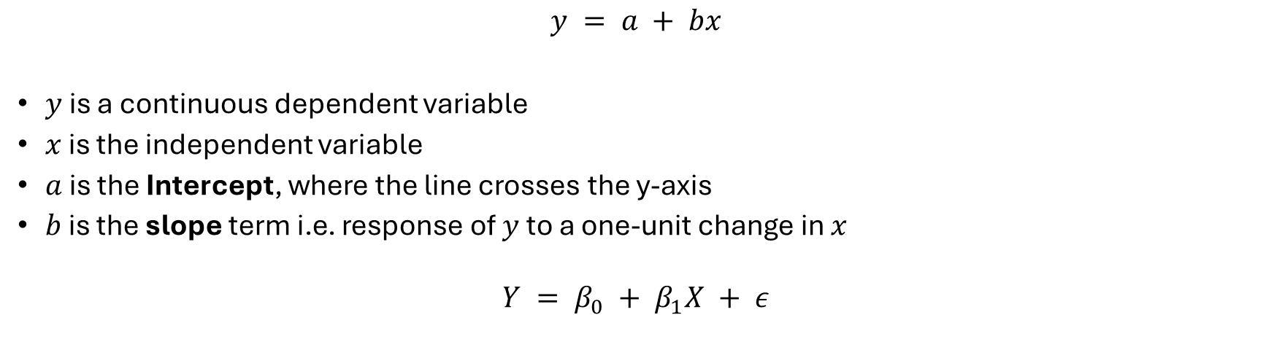
Regression
Regression is useful for:
Inference – what is the relationship between X and Y?
Prediction – what is the predicted value of Y given X?
$$y = a + bx$$
$y$ is a continuous dependent variable
$x$ is the independent variable
$a$ is the Intercept, where the line crosses the y-axis
$b$ is the slope term i.e. response of $y$ to a one-unit change in $x$
$$Y = β_{0} + β_{1}X + ε$$

Slide 4
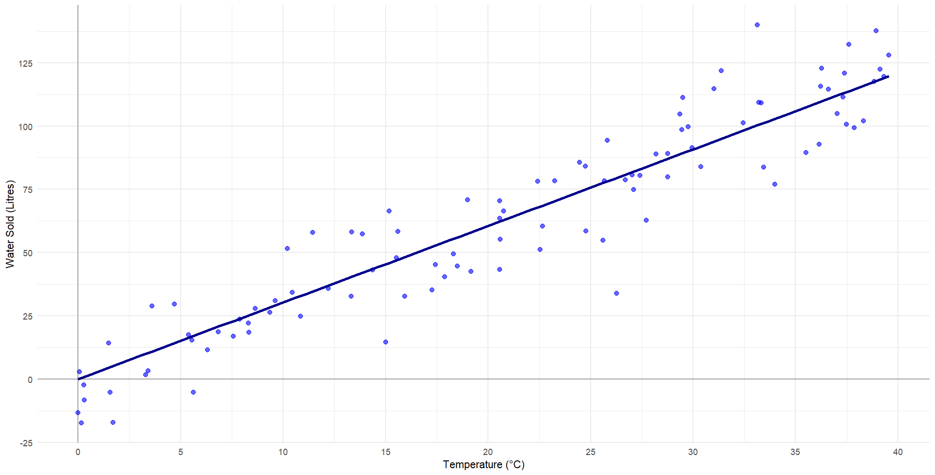
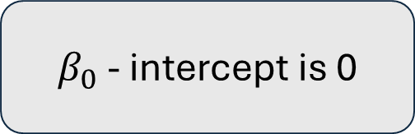
Bivariate regression
Y - the dependent variable, is put onto the vertical axis.
X - the independent variable, is put onto the horizontal axis
$β_{0}$ - intercept is 0

Slide 5
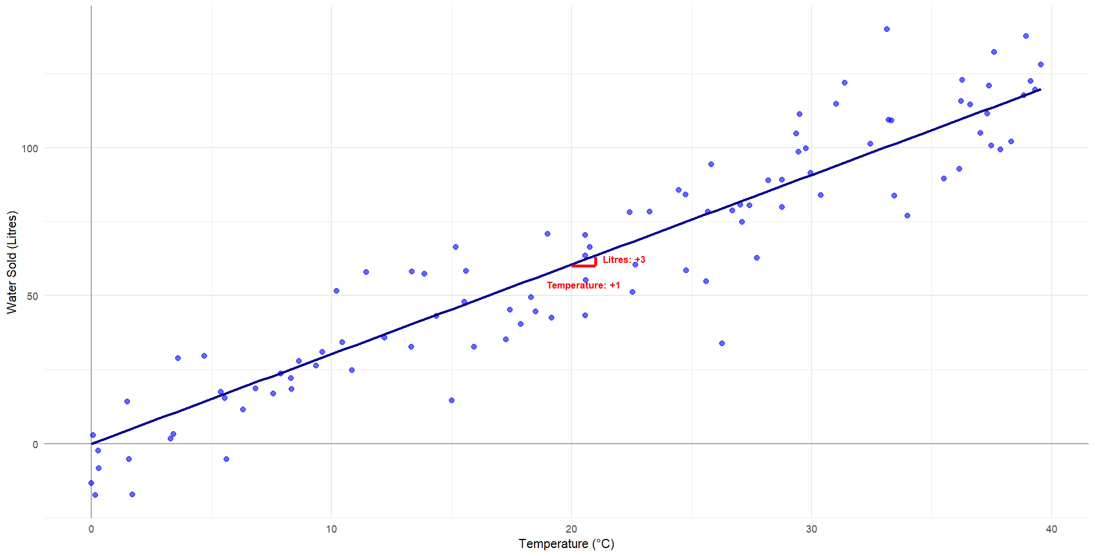
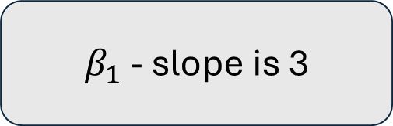
Bivariate regression
Y - the dependent variable, is put onto the vertical axis.
$β_{1}$ - slope is 3
X - the independent variable, is put onto the horizontal axis
$β_{0}$ - intercept is 0

Slide 6
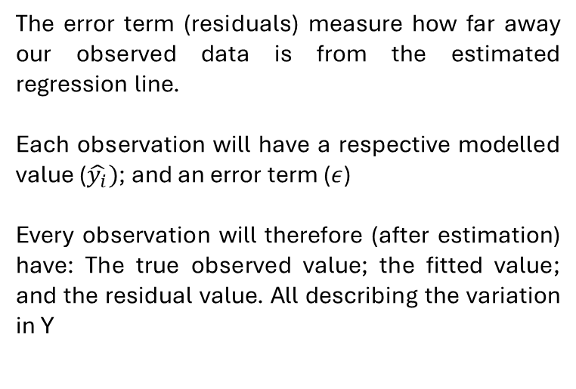
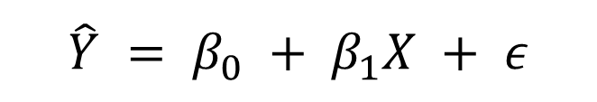
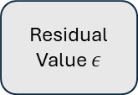
Bivariate regression – error term
The error term (residuals) measure how far away our observed data is from the estimated regression line.
Each observation will have a respective modelled value ($\hat{y_{i}})$; and an error term ($ε$)
Every observation will therefore (after estimation) have: The true observed value; the fitted value; and the residual value. All describing the variation in Y
$$\hat{Y} = β_{0} + β_{1}X + ε$$
Modelled Value of Y
y_{i}
(i.e. the line)
^
Residual Value $ε$
Observed Value of Y
y_{i}
(i.e. the points)

Slide 7
Regression Hypothetical Example
Survey of 250 people
Dependent variable is their annual earnings (£)
Independent variable is the university education (Y / N)
We also have data on:
Hours worked per week
Years in employment
Alternative hypothesis: annual earnings will increase with university education
Null hypothesis: there is no relationship between annual earnings and university education

Slide 8
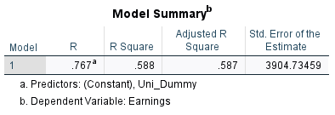
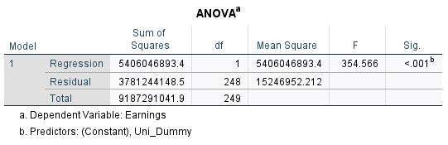
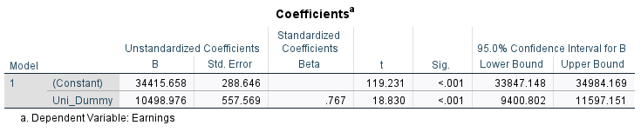
Bivariate regression
Unstandardized B: coefficient
R² : percentage variance explained
F-ratio: ratio of explained variance to unexplained variance (higher is better)
Sig.: p-value, the probability of a result at least as extreme as that observed assuming the null hypothesis is true, 0.05 conventional threshold
Confidence interval: representation of uncertainty; a range of values likely to contain the true value (under certain assumptions); the percentage comes from the percentage of intervals expected to contain the true value if the study was repeated

Slide 9
Bivariate regression
So, under this scenario we would reject the null hypothesis of no relationship
BUT we have a problem!
Omitted variable bias i.e. potential confounders

Slide 10
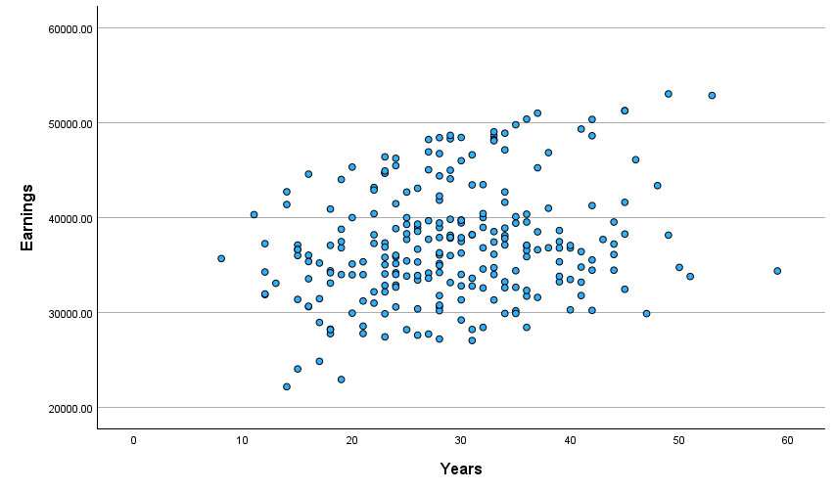
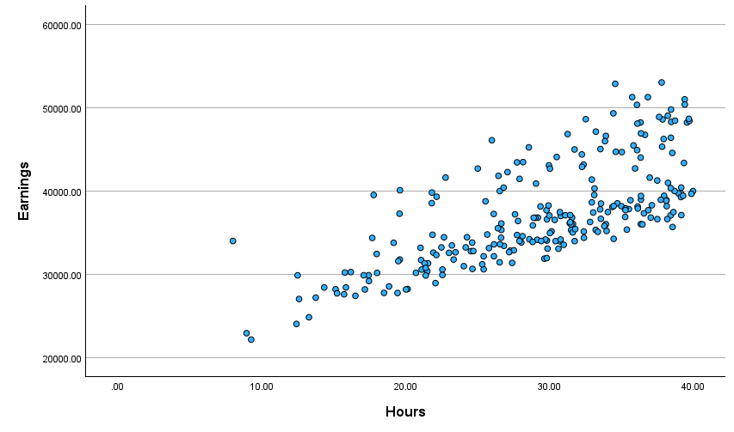
Multivariate regression

Slide 11
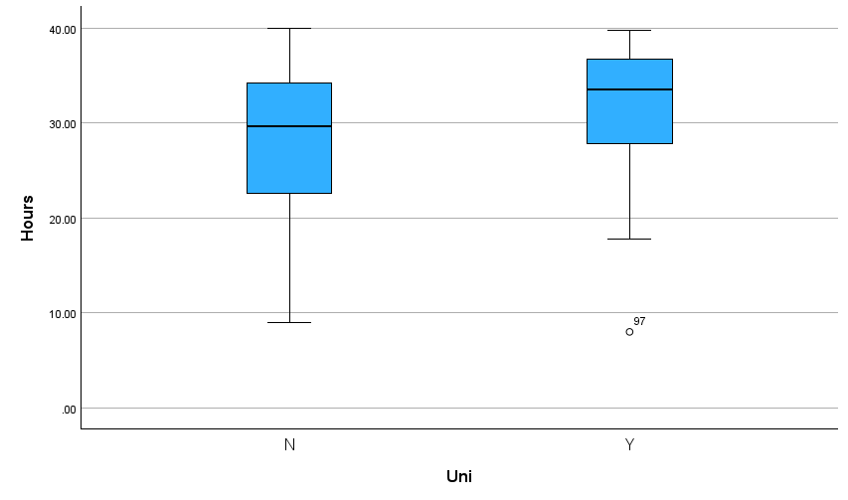
Multivariate regression

Slide 12

Multivariate regression
$$Y = β_{0} + β_{1}X_{1} +β_{2}X_{2}+β_{3}X_{3}+ε$$
Where:
$X_{1}$ is university education
$X_{2}$ is years worked
$X_{3}$ is hours worked per week

Slide 13
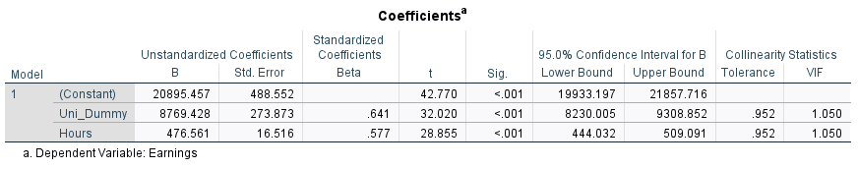
Multivariate regression
After controlling for Hours worked our coefficient for University education is reduced from 10498 to 8769
The relationship between hours worked with both earnings and university education had inflated our coefficient

Slide 14

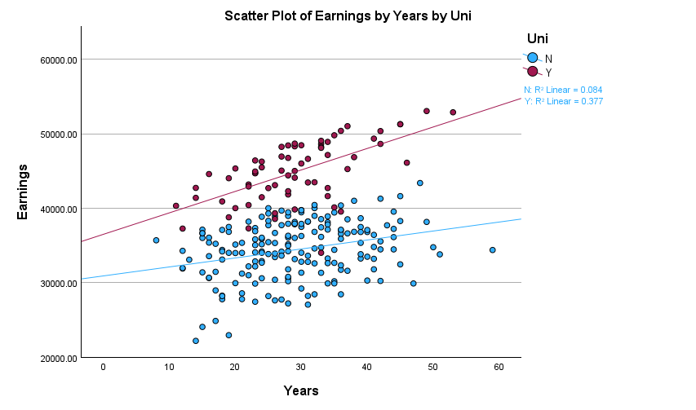
Interaction terms

Slide 15
Interaction terms
University education interacts with years worked to determine earnings
The effect of years worked is moderated by university education
The slope for graduates is steeper

Slide 16
Interaction terms
We represent an interaction numerically by multiplying the independent variables together, and using this as an additional variable
$$Y = β_{0} + β_{1}X_{1} +β_{2}X_{2}+β_{3}X_{3}+β_{4}{(X}_{1}X_{2})+ ε$$
$$Y = β_{0} + β_{1}Uni +β_{2}Years+β_{3}Hours+β_{4}(Uni ×Years)+ ε$$

Slide 17
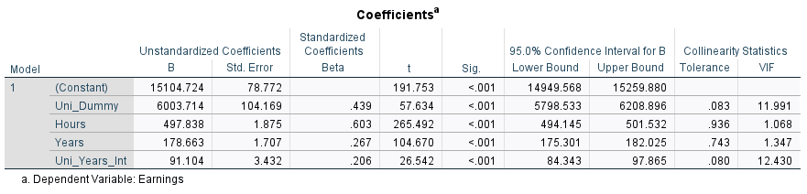
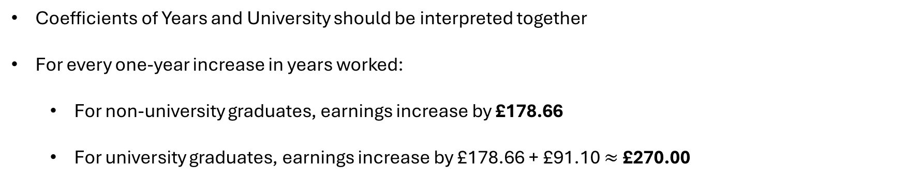
Multivariate regression with interaction term
Coefficients of Years and University should be interpreted together
For every one-year increase in years worked:
For non-university graduates, earnings increase by £178.66
For university graduates, earnings increase by £178.66 + £91.10 $≈$ £270.00

Slide 18
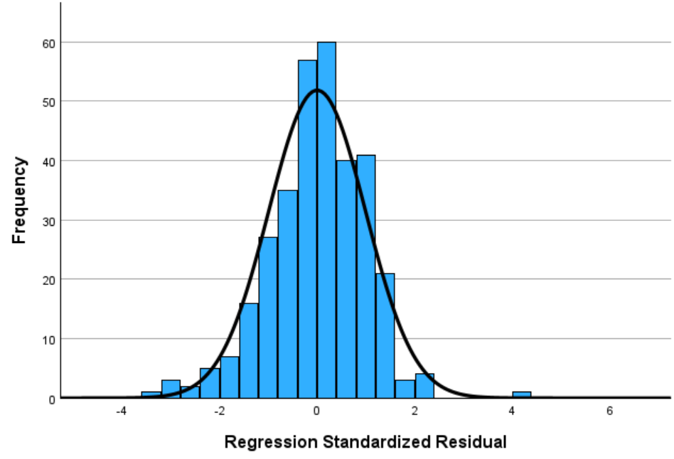
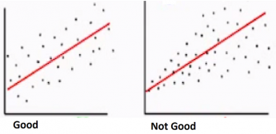
Regression assumptions
No omitted variable bias
Independence of observations
Normality of residuals
Homoscedasticity

Slide 19
Regression – other diagnostics
Multicollinearity – independent variables ideally not highly correlated with one another
Variance inflation factor – below 5
Outliers – can bias the coefficient estimate
Need strong justification to remove outliers e.g. data entry error

Slide 20
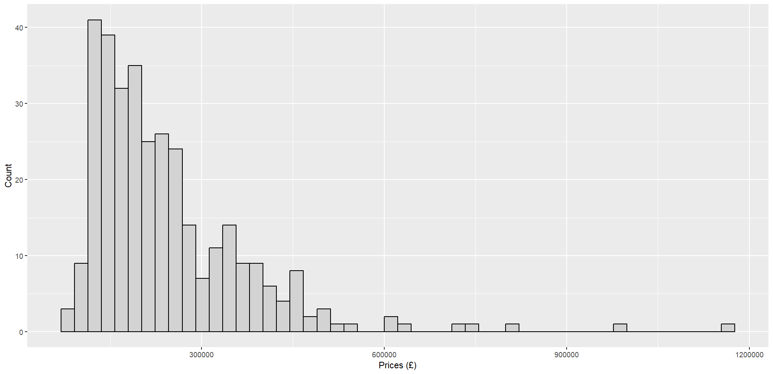
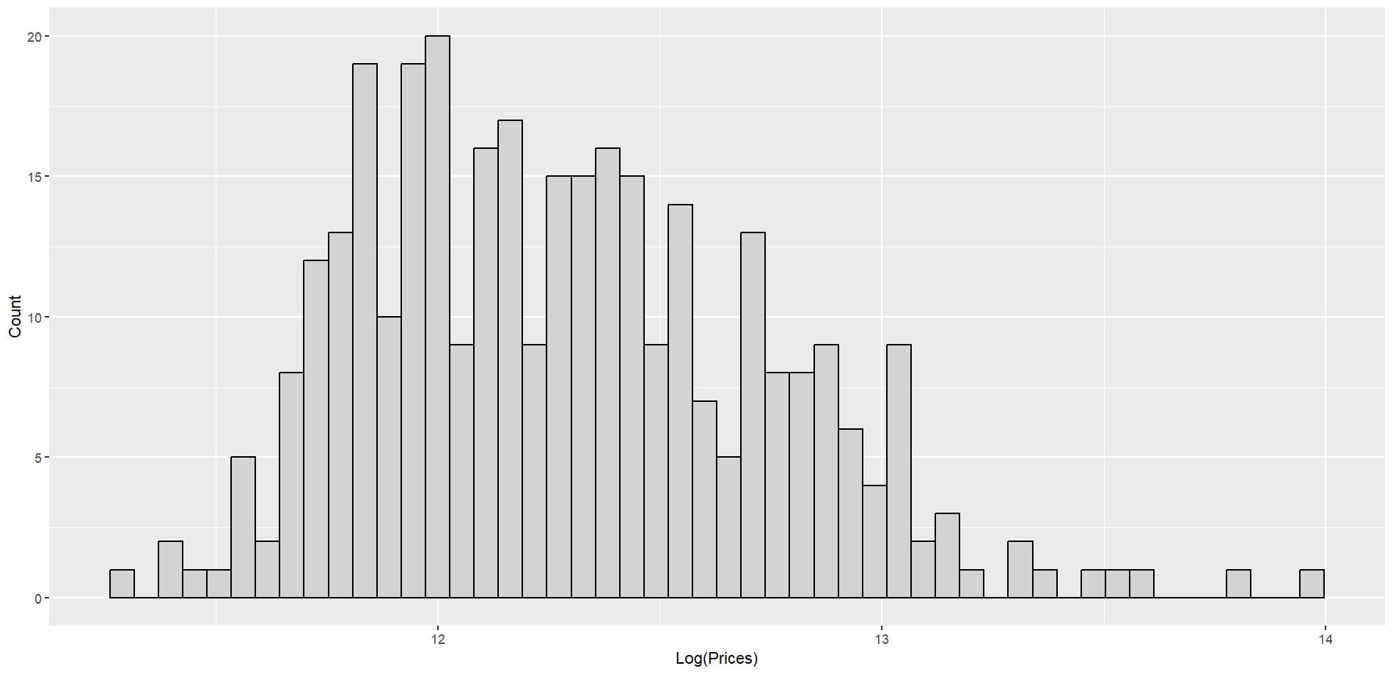
Transformation
Often used for managing skewed variables
Examples:
Income
House prices
Most common is log transformation

Slide 21
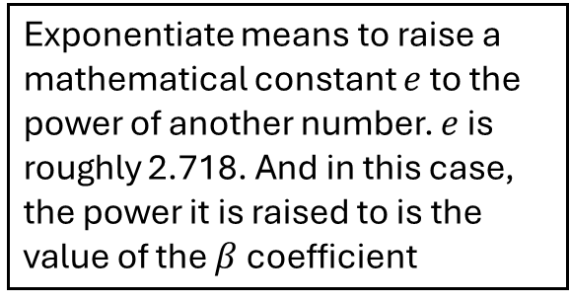
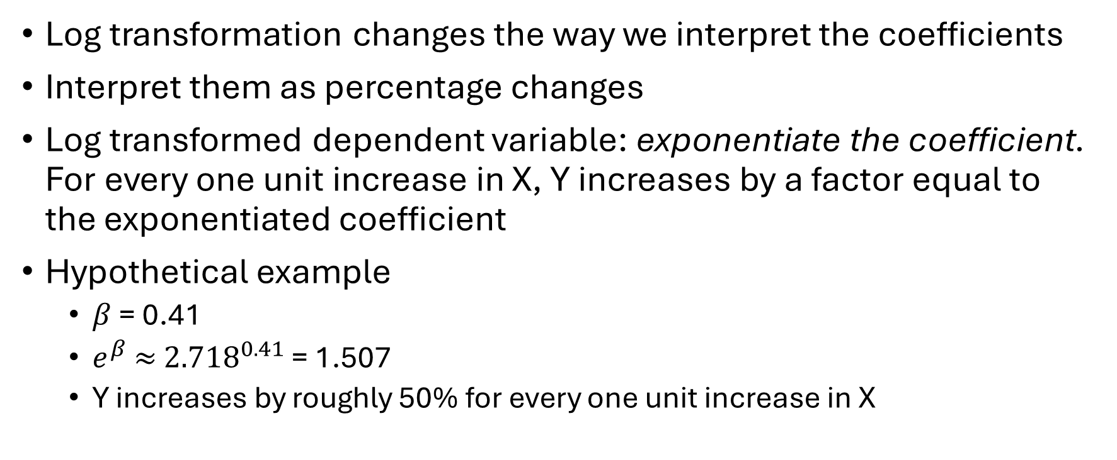
Transformation
Exponentiate means to raise a mathematical constant $e$ to the power of another number. $e$ is roughly 2.718. And in this case, the power it is raised to is the value of the $β$ coefficient
Log transformation changes the way we interpret the coefficients
Interpret them as percentage changes
Log transformed dependent variable: exponentiate the coefficient. For every one unit increase in X, Y increases by a factor equal to the exponentiated coefficient
Hypothetical example
$β$ = 0.41
$e^{β}$ $≈$ ${2.718}^{0.41}$ = 1.507
Y increases by roughly 50% for every one unit increase in X

Slide 22
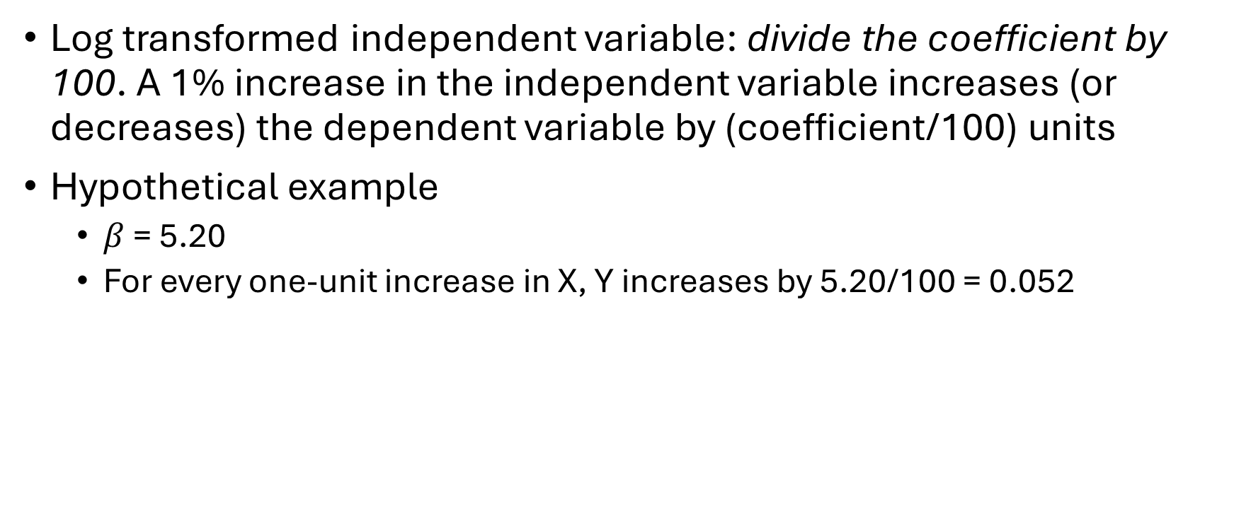
Transformation
Log transformed independent variable: divide the coefficient by 100. A 1% increase in the independent variable increases (or decreases) the dependent variable by (coefficient/100) units
Hypothetical example
$β$ = 5.20
For every one-unit increase in X, Y increases by 5.20/100 = 0.052

Slide 23
Transformation
Log-log model i.e. log transformed dependent and independent variable
Interpret the coefficient as the percent increase in the dependent variable for every 1% increase in the independent variable

Slide 24
Summary
Regression is a statistical method that can be used for inference and prediction
It is modelled using an:
Intercept – the point where the slope crosses the y-axis
Coefficient (i.e. slope) – the steepness of the line i.e. response of Y to one unit increase in X
Error term – residual distance between the observed value and the modelled value
Accompanied by statistics to evaluate the model:
R² : goodness of fit
p-value: below 0.05 conventional threshold for statistical significance
Confidence intervals: range of likely values for the true value
Regression makes assumptions about the data which need checking
Interactions model the moderation of two variables by one another
Transformations can deal with skewed variable but change the interpretation of coefficients

Slide 25
Workshop examples
Do perceptions of Keir Starmer’s competency vary by social class?
Null hypothesis: there is no relationship between social class and perceptions of Starmer’s competency
Alternative hypothesis: Manual, partly skilled and unskilled occupations will see Starmer as less competent than professional occupations
Were low house prices associated with support for Brexit?
Null hypothesis: there is no relationship between house prices and support for Leave in the 2016 referendum
Alternative hypothesis: house prices are negatively associated with support for Leave in the 2016 referendum

